Slide 1

USC Solar Roof System
Group 4
Michelle Gelman
Najeeb Gohil
Simran Kang
Harrison Lee
Naseem Pashai
Francisco Rocha
Rahul Sheth
ISE 515 - Engineering Project Management
Dr. Yalda Khashe
7/16/2024

Slide 2
Table of Contents
Project Scope & SOW
01
02
Work Breakdown Structure
Risk Assessment
Cost Estimation & Budgeting
03
04
Michelle & Harrison
Naseem & Francisco
Simran, Francisco & Rahul
Harrison & Najeeb

Slide 3
01
Project Scope
Overview of project goals, requirements, and objectives

Slide 4
Problem Introduction
Stakeholders
Strategic Initiatives
Presidential Working Group (PWG) at USC
Assignment Earth:
Net Campus Carbon Neutrality by 2025
Executive Order B-55-18:
Net Campus Carbon Neutrality by 2045
State of California
Los Angeles Department of Water and Power
EEEB + Smarter Grid
Energy Rebates and improved Grid utility efficiency

Slide 5
Market & Business Case
Executive Order B-55-18:
Assignment Earth
Smart Grid Program
Save California $200 Billion in health care costs by 2045
Carbon offset purchasing expected to increase 6x by 2035
USC purchases 30% of LADWP Springbok 3 Solar Farm Capacity

Slide 6
Market & Business Case
Solar Roof Project
Executive Order B-55-18:
Assignment Earth
Smart Grid Program
Save California $200 Billion in health care costs by 2045
Carbon offset purchasing expected to increase 6x by 2035
USC purchases 30% of LADWP Springbok 3 Solar Farm Capacity
Cost Saving on-campus project with higher ROI

Slide 7
Scope Definition
USC Solar Roof Installation
USC Fiscal Year 2028
Achieve a platinum rating for the Sustainability Tracking, Assessment & Rating System (STARS) report.
Building capacity of 50,000 square feet and an energy capacity of 1000

Slide 8
Scope Management
Product
Deliver and install all required solar panels, inverters, mounting hardware on 50,000
square foot USC facility.
Cost
Stay within expected budget of
$5,257,923
Project Deliverables
Complete installation at least by FY 2028
to meet Assignment: Earth net neutrality
target of neutral carbon emissions
Schedule
Produce a 1000 KW solar panel with
tolerance of +/- 5% power rating.
Performance

Slide 9
Scope Management
Product
Shall meet stakeholder and local inspection and certification standards
Cost
Shall be kept to $5.2 million +/- 6%
Acceptance Criteria
Shall be completed within a maximum 2-year duration
Schedule
Shall achieve at least 85% efficiency under verification & validation test for final installation
Performance

Slide 10
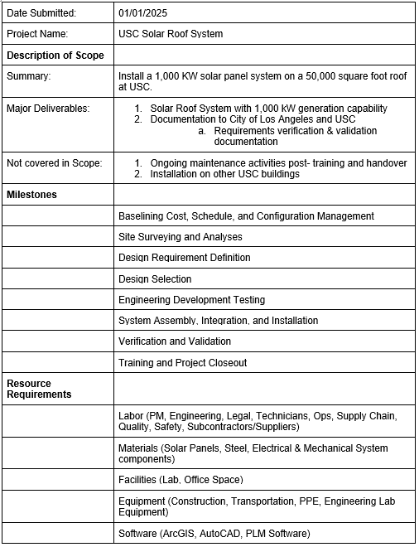
Statement of Work (SOW)

Slide 11
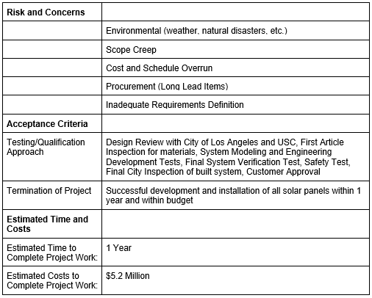
SOW
continued

Slide 12
02
Work Breakdown Structure
Decomposition of scope to meet project objectives and establish deliverables

Slide 13
Deliverables
1. Project Planning
2. Site Assessment & Preparation
3. Design & Engineering
4. Procurement & Installation
5. Verification & Validation
6. Training & Project Closeout
1.1 Project Management
1.2 Resource Management
1.3 Configuration Management
2.1 Site Surveying
2.2 Site Readiness
2.3 Design Requirements Definition
3.1 Computer-aided System Modeling
3.2 Design Selection
4.1 Components Receipt & Inspection
4.2 System Integration & Installation
5.1 Commissioning & Testing
6.1 - 6.4 Training Activities
6.5 Final Programmatic Review

Slide 14
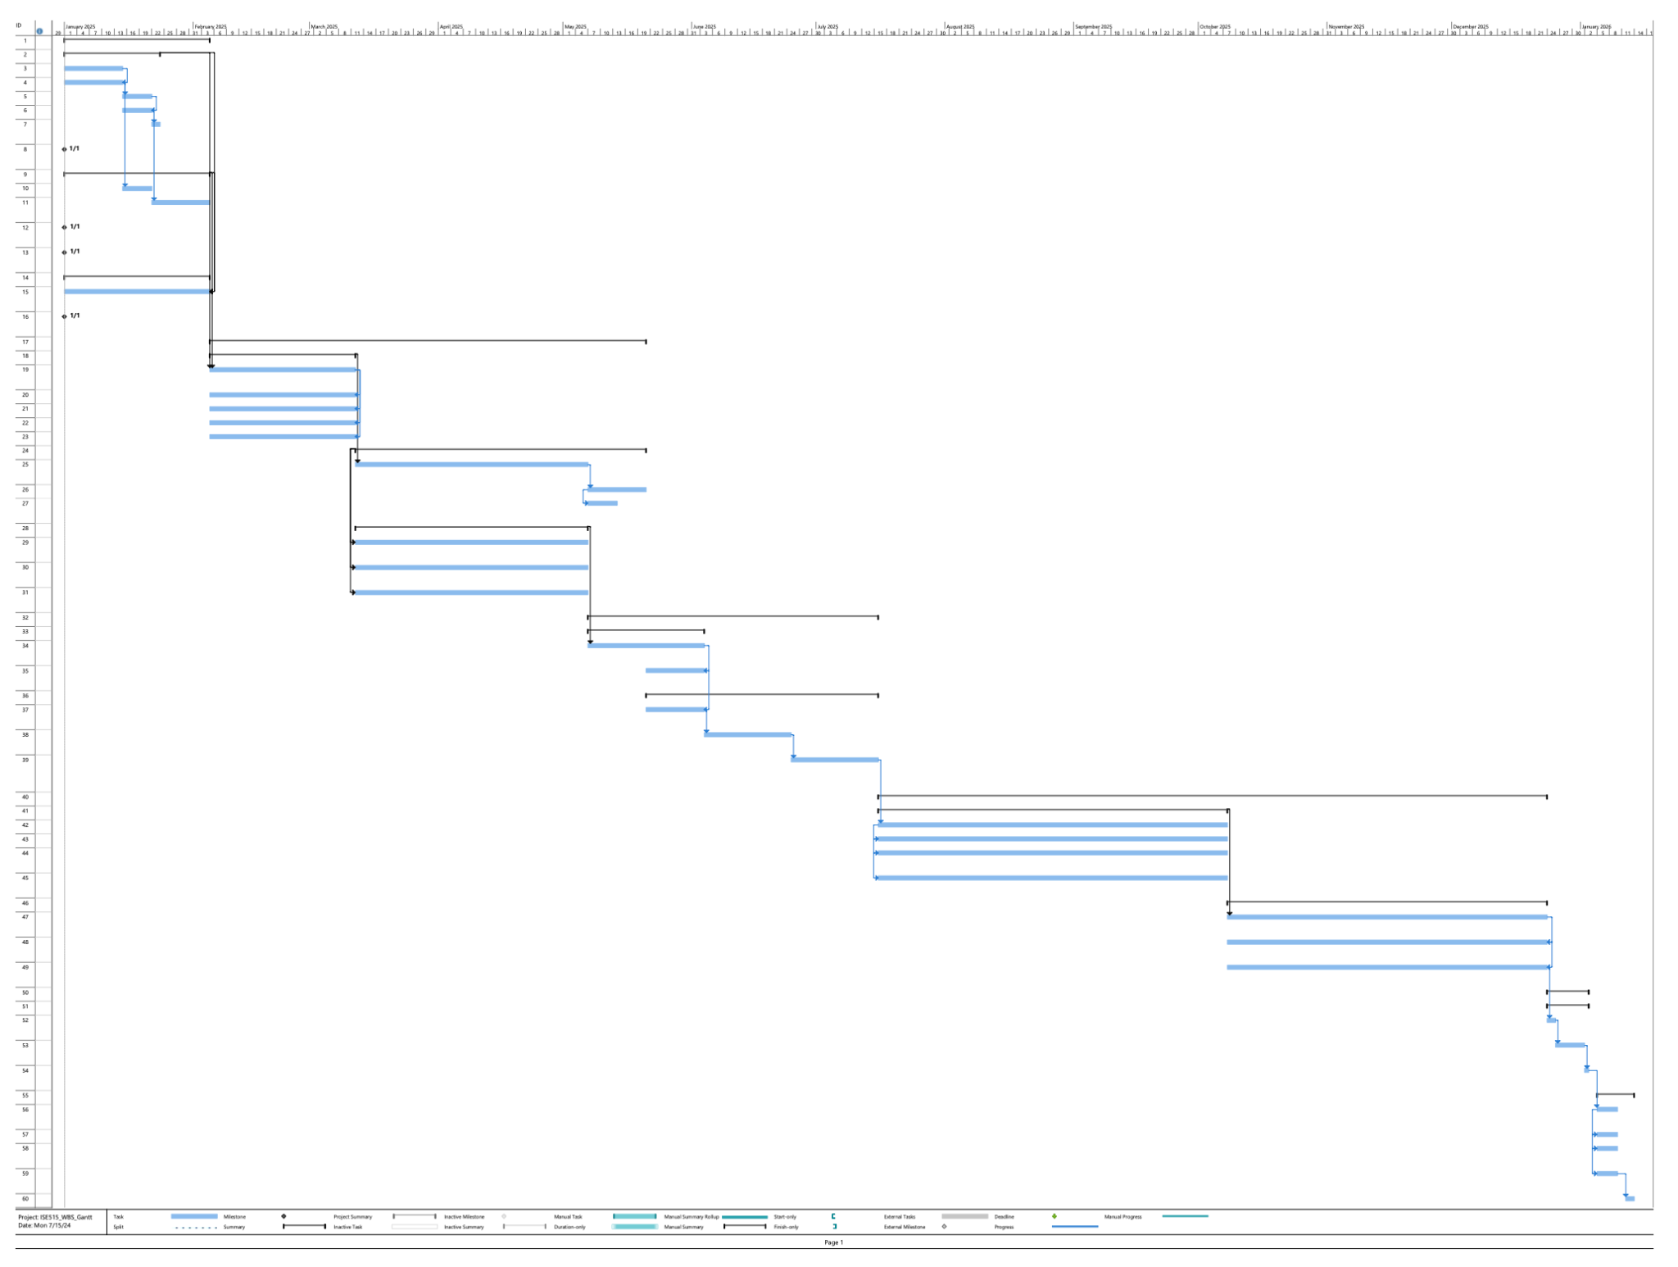
Solar Roof Project Gantt Chart
1/1/25 - 1/13/26

Slide 15
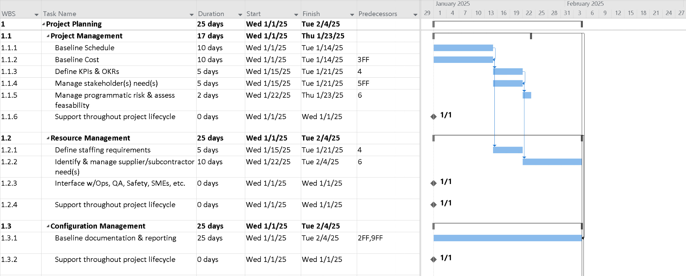
Project Planning

Slide 16
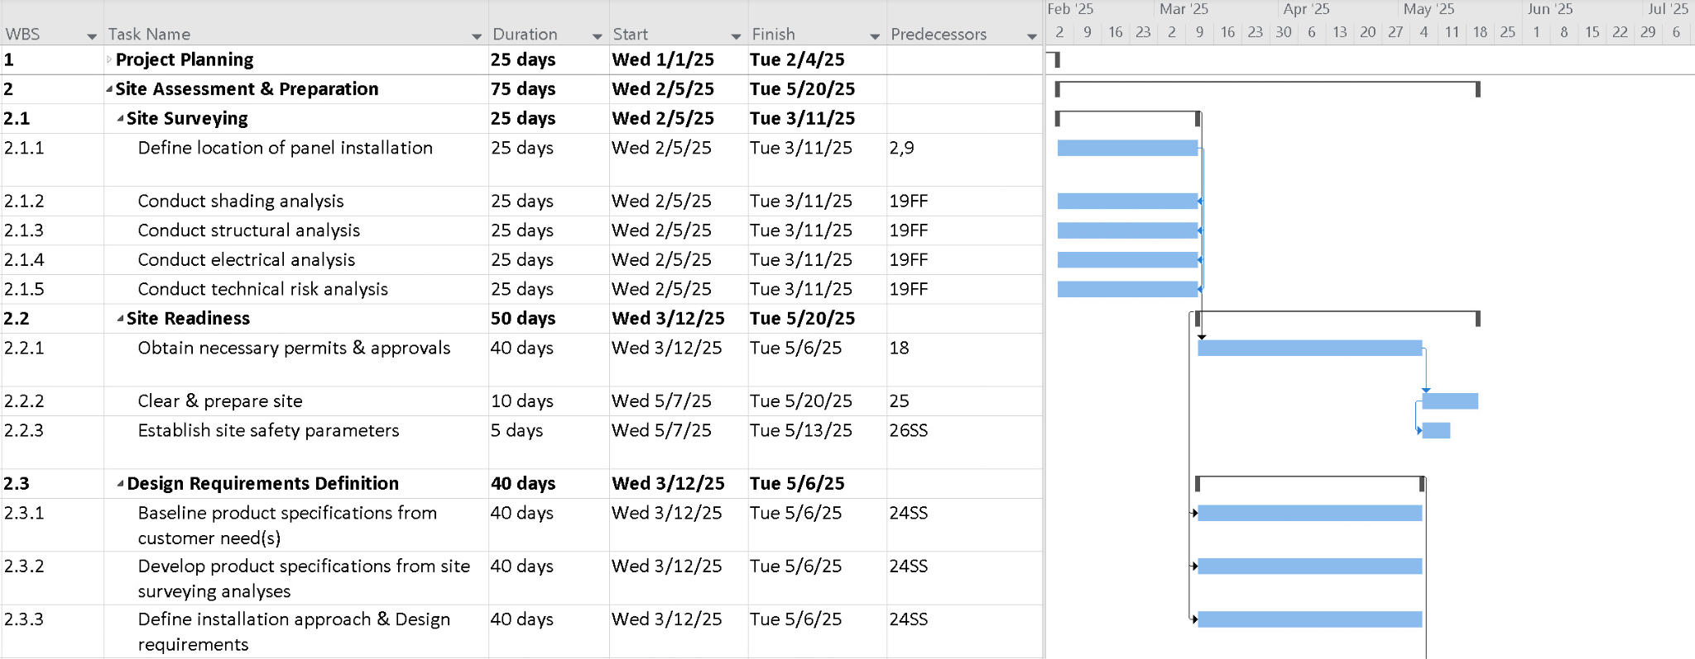
2. Site Assessment & Preparation

Slide 17
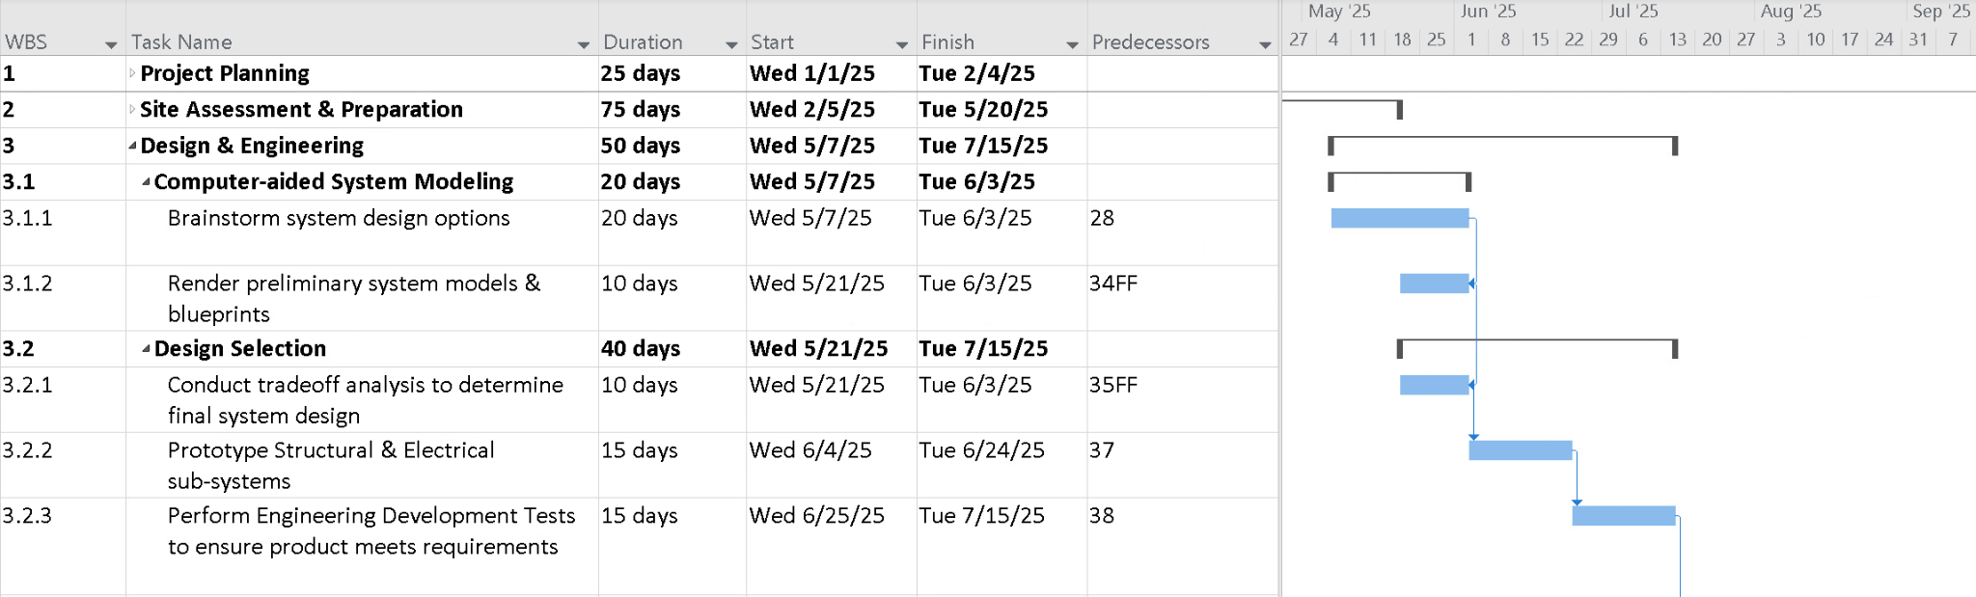
3. Design & Engineering

Slide 18
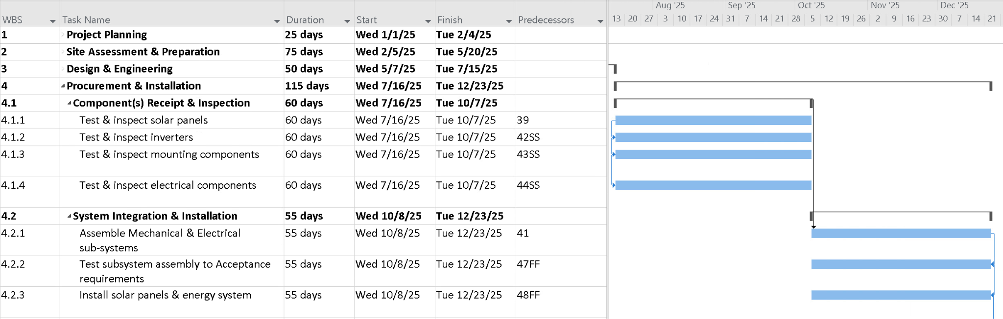
4. Procurement & Installation

Slide 19
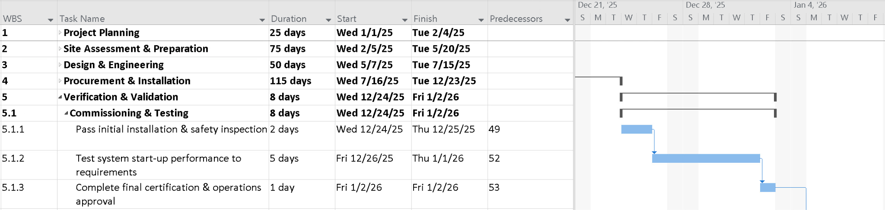
5. Verification & Validation

Slide 20
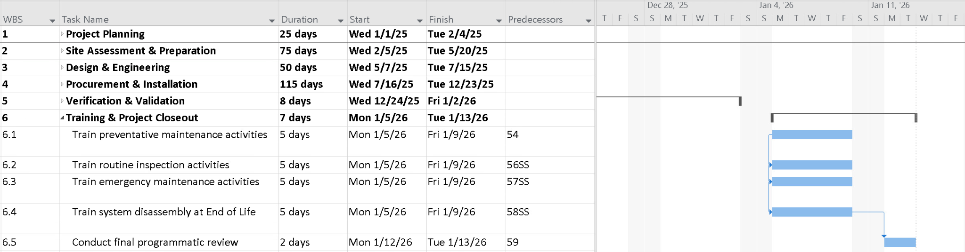
6. Training & Project Closeout

Slide 21
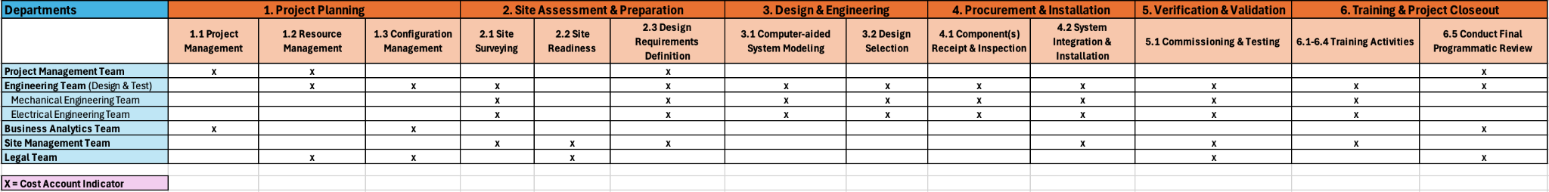

Organizational Breakdown Structure

Slide 22
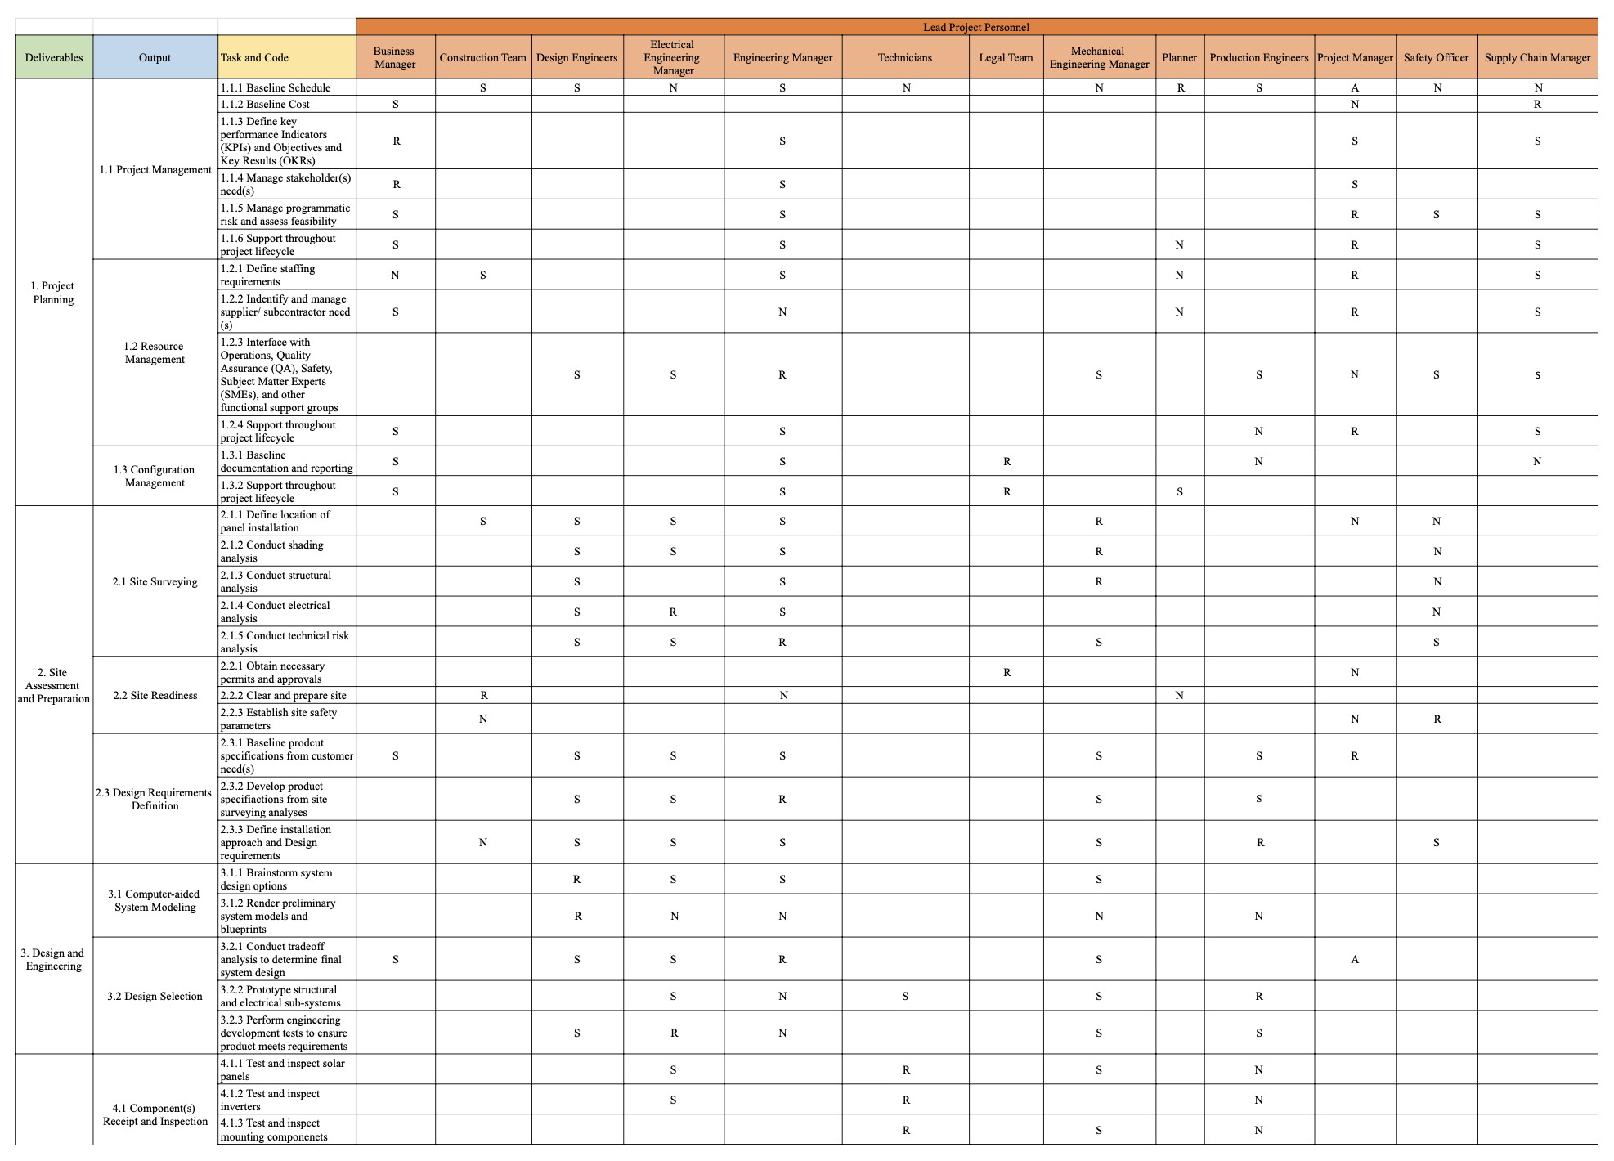
RAM

Slide 23
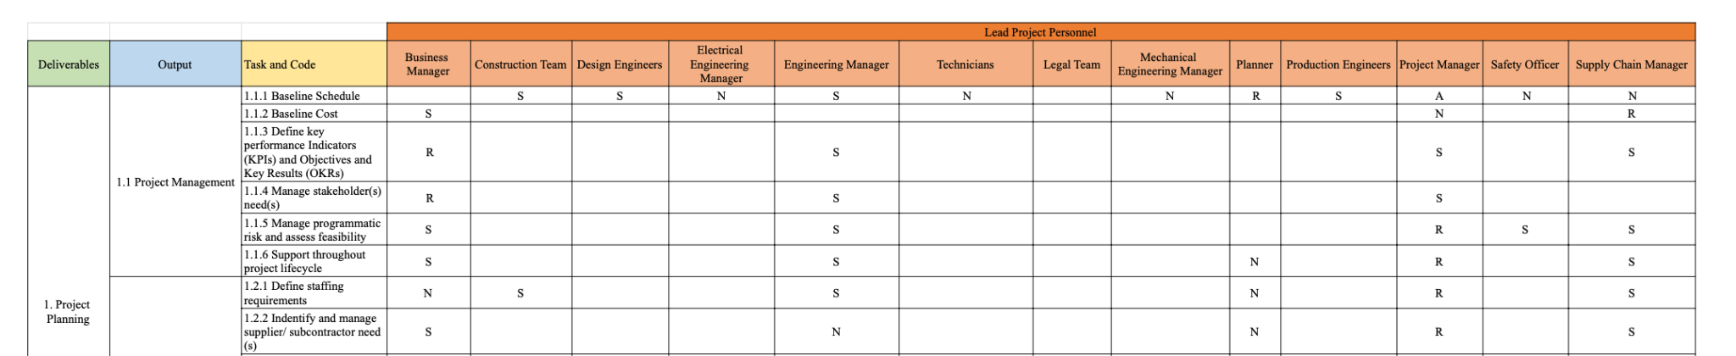
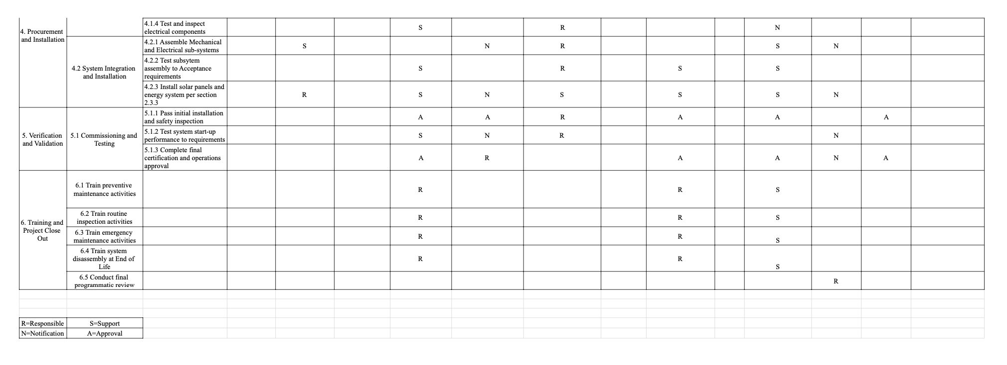
RAM
continued

Slide 24
03
Risk Assessment
xx
Notes:
Michelle
Mitigation strategies - simran and fransisico
Rahul

Slide 25
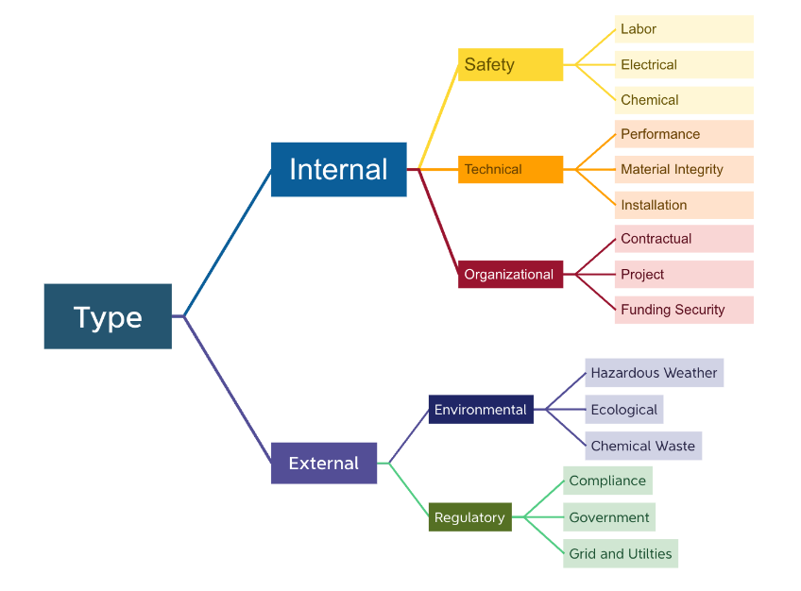
Resource Breakdown Structure (RBS)

Slide 26
Risk Identifications
The project management team were able to identify five risk groups that can potentially affect the project.
Environmental Risk: potential hazardous risks and dangers to the environment
Organizational Risk: risk that can be produced by human error in the organization that would affect operations
Regulatory Risk: government/stakeholder regulations that can affect the project
Safety Risk: workplace hazards that can potentially be disruptive to the project
Technical Risk: performance failures that can negatively impact the project

Slide 27
Risk Analysis Definitions
Likelihood Scale:
Rare: Most certainly will never occur at all under baseline project conditions
Unlikely: Typically won't occur under baseline project conditions
Probable: May occur at least once under normal project conditions
Likely: Expected to occur a few times under normal project baseline conditions
Most Certain: Frequent occurrence under normal project baseline conditions
Consequence Scale:
Inconsequential: The risk has a negligible effect on moving between project gates, schedule reliability and performance
Minimal: The risk has minimal effect on moving between project gates, schedule, reliability, and performance processes
Moderate:The risk creates moderate setbacks on moving between project gates, schedule, reliability, or performance processes
Significant:The risk creates significant barriers to moving between project gates, schedule, reliability, or performance processes
Severe: The risk has major ramifications on halting project gates, schedule, reliability, or performance processes

Slide 28
Qualitative Risk Impact Matrix
 |  | Consequence
 |  | Inconsequential | Minimal | Moderate | Significant | Severe
Likelihood | Rare |  | E.E.4, E.E.5 | E.E.3, E.HW.4, O.C.1, O.C.2 | O.F.1, R.G.1 | T.MI.1, T.I.1
 | Unlikely | E.E.1 | E.E.6 | R.G.1,S.L.2, T.I.1 | S.E.2, S.L.1
 | Probable |  | E.HW.5, T.I.3, E.HW.3 | E.HW.1, E.HW.6, T.P.1,
 | Likely | E.HW.2,T.P.4 | E.E.2, LR.GU.2, T.P.3 | R.G.3, R.G.4, T.I.2, T.P.2 | E.CW.1, R.G.4,
 | Most Certain
Legend | Low Risk | Moderate Risk | High Risk | Very High Risk

Slide 29
Qualitative Risk Impact Matrix
 |  | Consequence
 |  | Inconsequential | Minimal | Moderate | Significant | Severe
Likelihood | Rare |  | E.E.4, E.E.5 | E.E.3, E.HW.4, O.C.1, O.C.2 | O.F.1, R.G.1 | T.MI.1, T.I.1
 | Unlikely | E.E.1 | E.E.6 | R.G.1,S.L.2, T.I.1 | S.E.2, S.L.1
 | Probable |  | E.HW.5, T.I.3, E.HW.3 | E.HW.1, E.HW.6, T.P.1,
 | Likely | E.HW.2,T.P.4 | E.E.2, LR.GU.2, T.P.3 | R.G.3, R.G.4, T.I.2, T.P.2 | E.CW.1, R.G.4,
 | Most Certain
Legend | Low Risk | Moderate Risk | High Risk | Very High Risk

Slide 30
Project Phase Risk Load
Environmental Risks
Historical evidence about ecological impacts, generalize to urban areas
These risks will require preliminary impact analysis and design considerations at the least.
Technical Risks
Monitoring needed post-closeout of the installation project.
These risks will require disclosure, monitoring and maintenance checks.
Regulatory Risks
Governments and and federal agencies are highly irregular.
These risks require transfer or development with disclosure and acknowledgment.

Slide 31
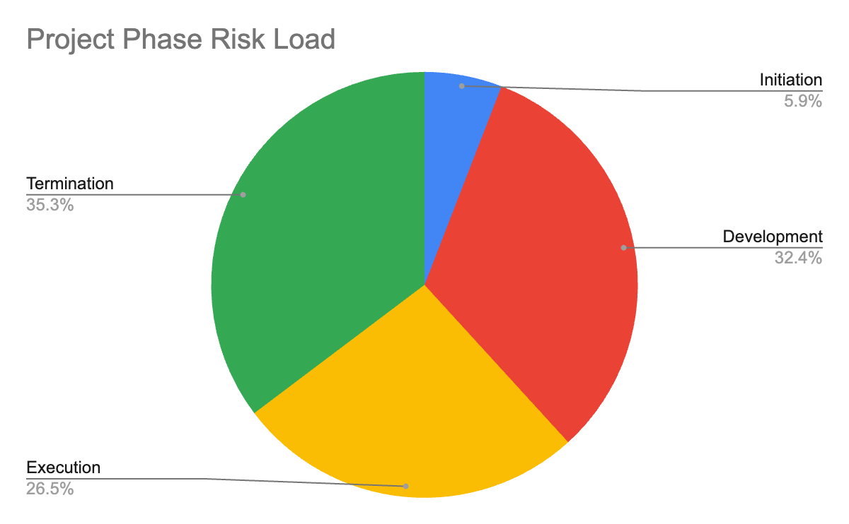
Project Phase Risk Load

Slide 32
Risk Mitigation Strategies
To prioritize which risk factors to address first, the project management team would focus on the constructed qualitative risk matrix. This matrix helps identify the most severe to inconsequential risk in the USC Solar Roof System project. There are four risk categorization mitigation strategies that help label the risk such as acceptable, minimizing, shared, and transferable. By utilizing these methods, the risks can be processed to identify which risk to address first in the project.
Acceptable: accepted the risk and responsible for the consequences
Minimizing: reduce the impact of the risk on the project
Shared: responsibility is shared with other organizations to minimize risky activities
Transferable: risk reduction method that defers the risk to a third party such as insurance

Slide 33
Risk Mitigation Strategies
Risk | Likelihood | Consequences | Mitigation Approach | Mitigation Category
Lead and cadmium environmental leaching (Very High Risk) | Likely | Significant | Ensure the solar panel material and coating is water-tight for entire panel EOL or require ongoing leakage maintenance checks. Source lead-free solders for PV panels. | Minimize
Political Instability in regions where contractors operate cause sourcing delays (Very High Risk) | Likely | Significant | Establish contingency plans with multiple suppliers | Minimize
Incorrecting cable placement and panel angles (High Risk) | Unlikely | Moderate | Perform checks on cable placement and panel angels to ensure proper installation | Minimize
Live cable wiring increasing risk of electrical shock (High Risk) | Unlikely | Significant | Wearing correct PPE and using proper tools and equipment in handling the wire, as well as training | Minimize

Slide 34

Quantitative Risk Assessment
Risk is made up of probability of the event occurring and the consequences of the event
The probability of failure is made up of 3 sections: Maturity, Complexity, and Dependency
consequences of failure are made up of 4 parts: Cost, Schedule, Reliability, and Performance
Notes:
A scale with an associated probability is assigned to each component of the probability of failure and the consequence of failure. These assigned probabilities are used to calculate the overall risk factor for the project.

Slide 35
Probability of Failure (Pf)
Score | Maturity | Complexity | Dependency
Low (0.1) | Existing solar panel system ready to implement (COTS) | Simple design | No impact on the project. The project is not dependent on the solar panel implementation.
Minor (0.3) | Minor modifications to readily available solar panel system | A minor increase in the complexity of the design | Due to the maturity/ complexity of the project, there is a minor impact on the schedule, cost, or implementation of the solar panels
Moderate (0.5) | Major Modifications to readily available solar panel system | Moderate increase in complexity of design | Moderate project impact (schedule, cost, or implementation due to maturity/ complexity level)
Significant (0.7) | A significant change from readily available solar panels development of new subsystem required | Significant increase in complexity design | Significant impact on the project timeline, cost, or other factors due to the development of new subsystems
Major (0.9) | Ground-up/brand-new solar panel system | Extremely complex design | Major impact on project due to ground-up development of solar panel system

Slide 36
Consequence of Failure (Cf)
Score | Cost | Schedule | Reliability | Performance
Low (0.1) | Budget not exceeded | Less than 1-week delay in schedule | Minimal (non-noticeable) reliability impact | Performance requirements are met. Redesign in not required
Minor (0.3) | Budget exceeds target by 1-6% | 2-3 weeks delay in schedule | A small decline in reliability impact | A small decline in performance. No redesign is required. All performance requirements are met
Moderate (0.5) | Budget exceeds target by 6-10% | 4-5 weeks delay in schedule (critical path impacted | Some reduction is reliability (noticeable) | Degradation of performance occurs. Performance requirements are met but without proper margins
Significant (0.7) | Budget exceeds target by 10-15% | 6-7 weeks delay in schedule (critical path must be delayed | Significant reliability decline | Significant decline in performance. Redesign is required and some performance requirements are not met
Major (0.9) | Budget exceeds target by more than 15% | More than 7 weeks delay in schedule (client is impacted by schedule delay | Solar panels do not meet reliability goals | No performance requirements are met. A complete redesign is required.

Slide 37
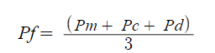
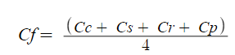
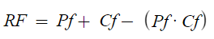
Calculation of risk factor
the calculated risk factor is 0.557
According to the rule of thumb for risk factors, this is considered a medium risk for the project, since the RF is between 0.3 and 0.7.

Slide 38
04
Cost Estimation and Budgeting
An estimate of key categories of the project: labor costs, materials costs, equipment and facilities cost

Slide 39
$4,572,107
Estimated Project Budget

Slide 40
$5,257,923
$685,816
Project Cost (15% Markup)
Profit

Slide 41
$3,200,475
USC Project Cost w/CA tax credit

Slide 42
$748,248.70
$523,858
$40,000
$3,300,000
Labor Worked w/ Additional Overhead (≈ $65000)
Materials, Equipment, & Permits
Facilities (Lab)
Solar Panels

Slide 43
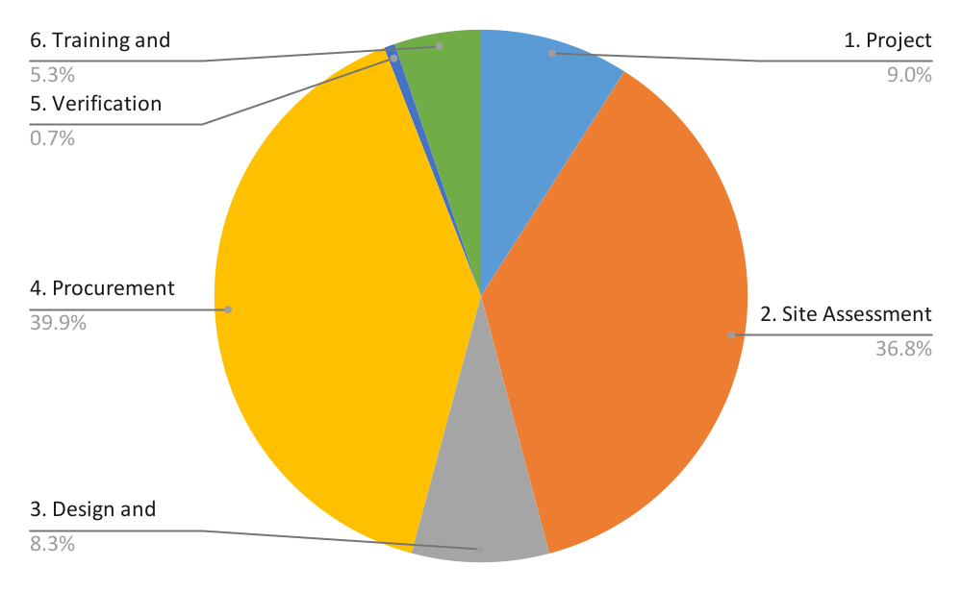
Financial Model
Deliverables

Slide 44
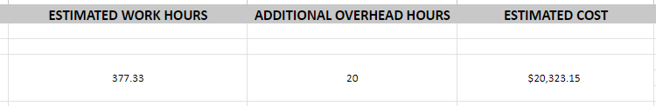
Labor Cost - Calculations

Slide 45
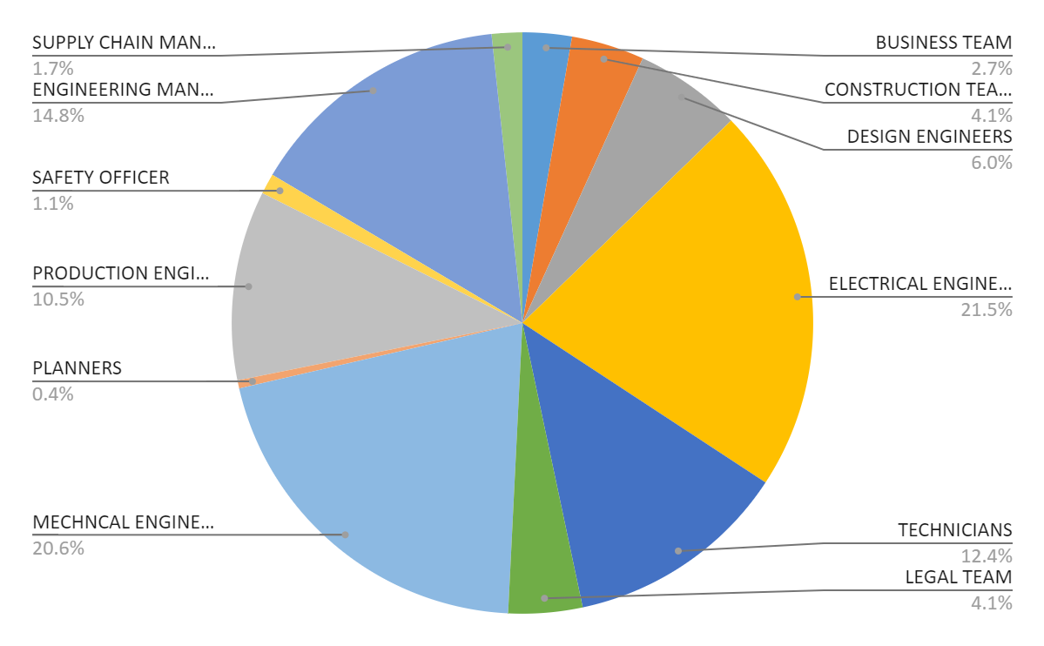
Financial Model
Labor Hours

Slide 46
Questions?

Slide 47
Thank You!

Slide 48
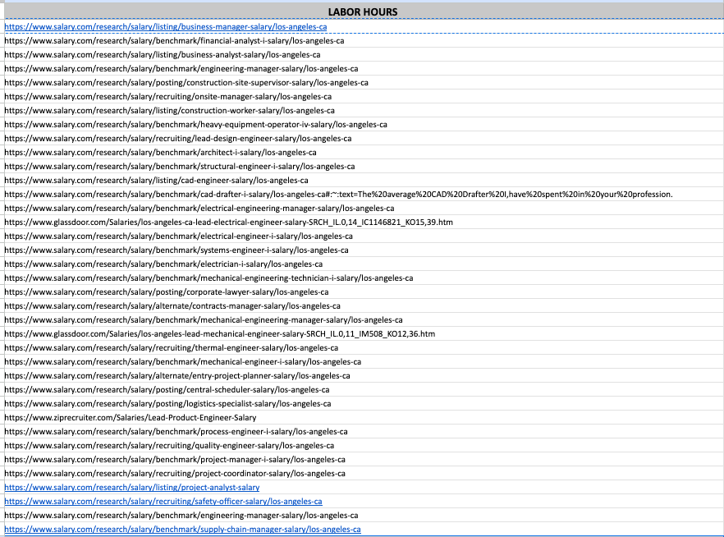
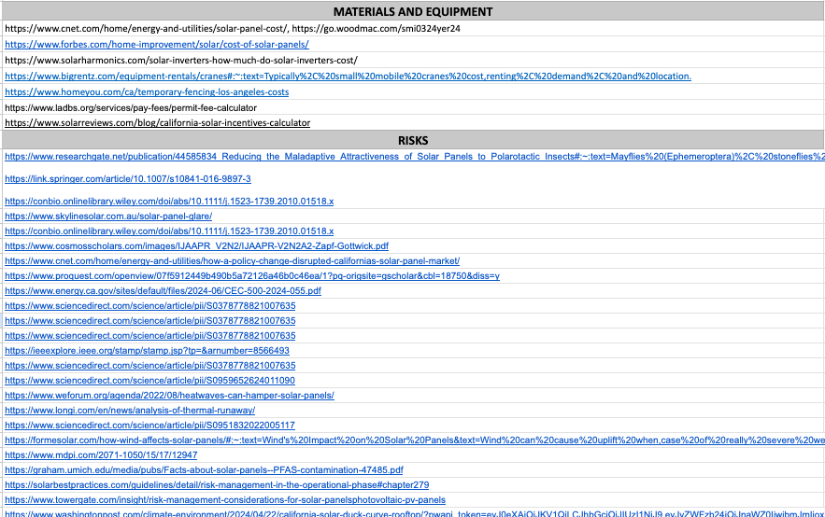
Works Cited

Slide 49
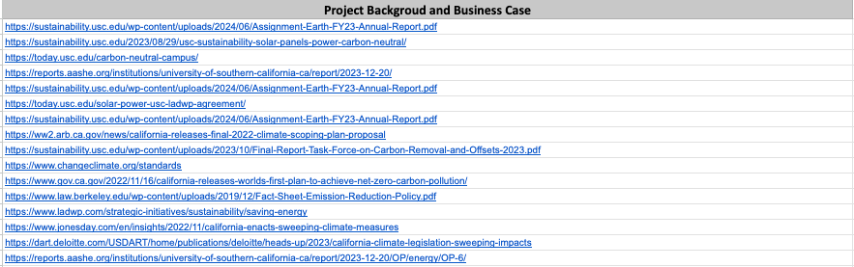
Works Cited

